Slide 1


Computer Networks
Lectures (Chapter4)
Network Layer: Data Plane
Subhan Ullah, PhD
subhan.ullah@nu.edu.pk
BS(Computer Science) Fall-2022

Slide 2
Network layer: our goals
understand principles behind network layer services, focusing on data plane:
network layer service models
forwarding versus routing
how a router works
addressing
generalized forwarding
Internet architecture
instantiation, implementation in the Internet
IP protocol
Network Address Translation (NAT)

Slide 3
Obtaining a Block of Addresses
Network administrator might first contact its ISP, which would provide addresses from a larger block of addresses that had already been allocated to the ISP
Example:
The ISP may itself have been allocated the address block 200.23.16.0/20.
Suppose a client requires 800 host addresses
The ISP, in turn, could divide its address block into eight equal-sized contiguous address blocks and give one of these address blocks out to each of up to eight organizations that are supported by this ISP

Slide 4
IP addressing: CIDR
CIDR: Classless InterDomain Routing (pronounced “cider”)
subnet portion of address of arbitrary length
address format: a.b.c.d/x, where x is # bits in subnet portion of address
subnet
part
host
part
11001000 00010111 00010000 00000000
200.23.16.0/23

Slide 5
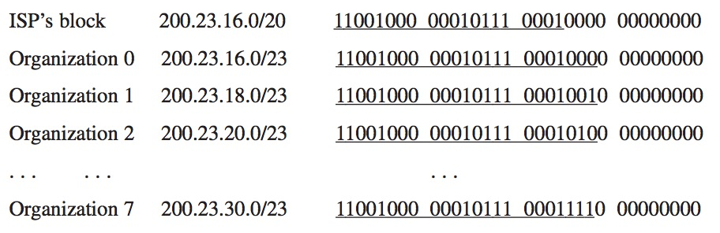
CIDR and Address assignments

Slide 6
Special IP Addresses
Reserved or (by convention) special addresses:
Loopback interfaces
all addresses 127.0.0.1-127.255.255.255 are reserved for loopback interfaces
Most systems use 127.0.0.1 as loopback address
loopback interface is associated with name “localhost”
IP address of a network
Host number is set to all zeros, e.g., 128.143.0.0
Broadcast address
Host number is all ones, e.g., 128.143.255.255
Broadcast goes to all hosts on the network
Often ignored due to security concerns
Test / Experimental addresses Certain address ranges are reserved for “experimental use”. Packets should get dropped if they contain this destination address (see RFC 1918):
10.0.0.0 -to- 10.255.255.255
172.16.0.0 -to- 172.31.255.255
192.168.0.0 -to- 192.168.255.255
Convention (but not a reserved address)
Default gateway has host number set to ‘1’, e.g., e.g., 192.0.1.1

Slide 7
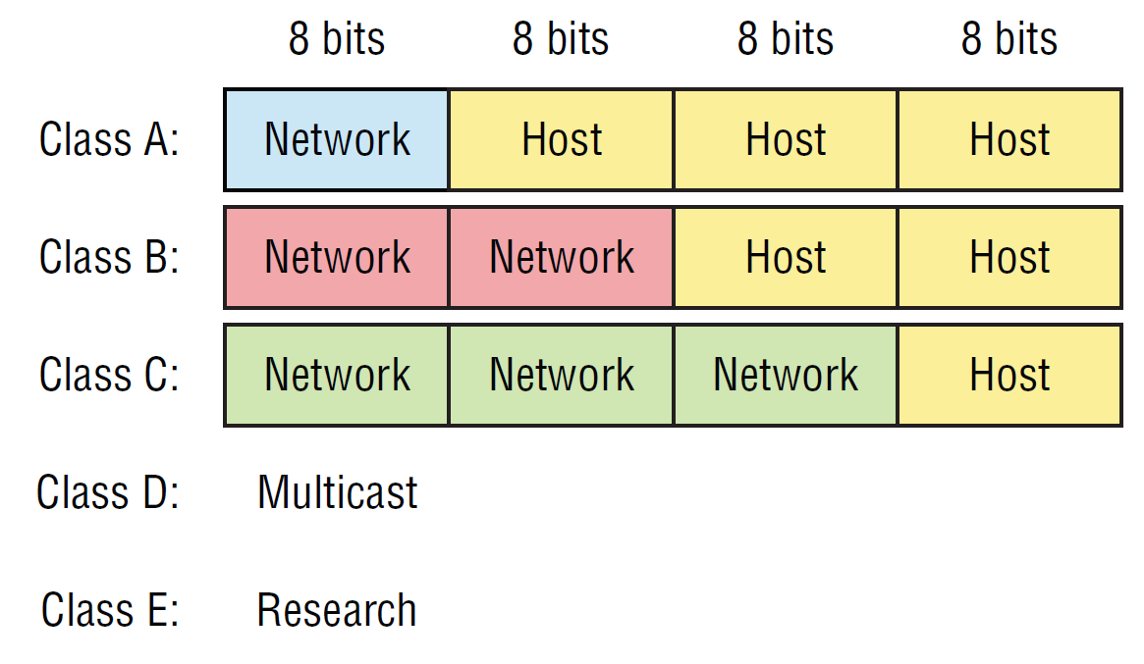
Classful IP Adresses (Until 1993)
When Internet addresses were standardized (early 1980s), the Internet address space was divided up into classes:

Slide 8
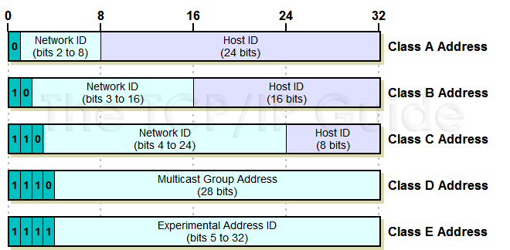
Identification of the class of address
http://www.tcpipguide.com/free/t_IPClassfulAddressingNetworkandHostIdentificationan-3.htm
Notes:
Section D covered: (08-12-2021)

Slide 9
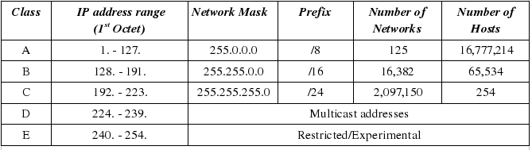
IP address ranges and number networks/hosts
7
https://www.telecomworld101.com/Classes.html
Notes:
Class D has IP address range from 224.0.0.0 to 239.255.255.255. Class D is reserved for Multicasting. In multicasting data is not destined for a particular host, that is why there is no need to extract host address from the IP address, and Class D does not have any subnet mask.
A router will determine if any of the hosts on a locally attached network are configured to receive multicast datagrams using IGMP( Internet Group Management Protocol).
Class E IP address is reserved for experimental purposes only for R&D or Study. IP addresses in this class ranges from 240.0.0.0 to 255.255.255.254. Like Class D, this class too is not equipped with any subnet mask.

Slide 10
Public and private IP address ranges
Class | Private IP addresses Range | Public IP address range
A | 10.0.0.0—10.255.255.255 | 1.0.0.0—9.255.255.255 11.0.0.0– 126.255.255.255
B | 172.16.0.0 – 172.31.255.255 | 128.0.0.0– 172.15.255.255 172.32.0.0—191.225.255.255
C | 192.168.0.0– 192.168.255.255 | 192.0.0.0– 192.167.255.255 192.169.0.0 – 223.225.255.255
How to remember the private addresses ranges?
Class A: 10.x.x.x
Class B: 172.16.x.x—172.31.x.x
Class C: 192.168.x.x
Notes:
Section F: Covered ; 10-12-2021

Slide 11
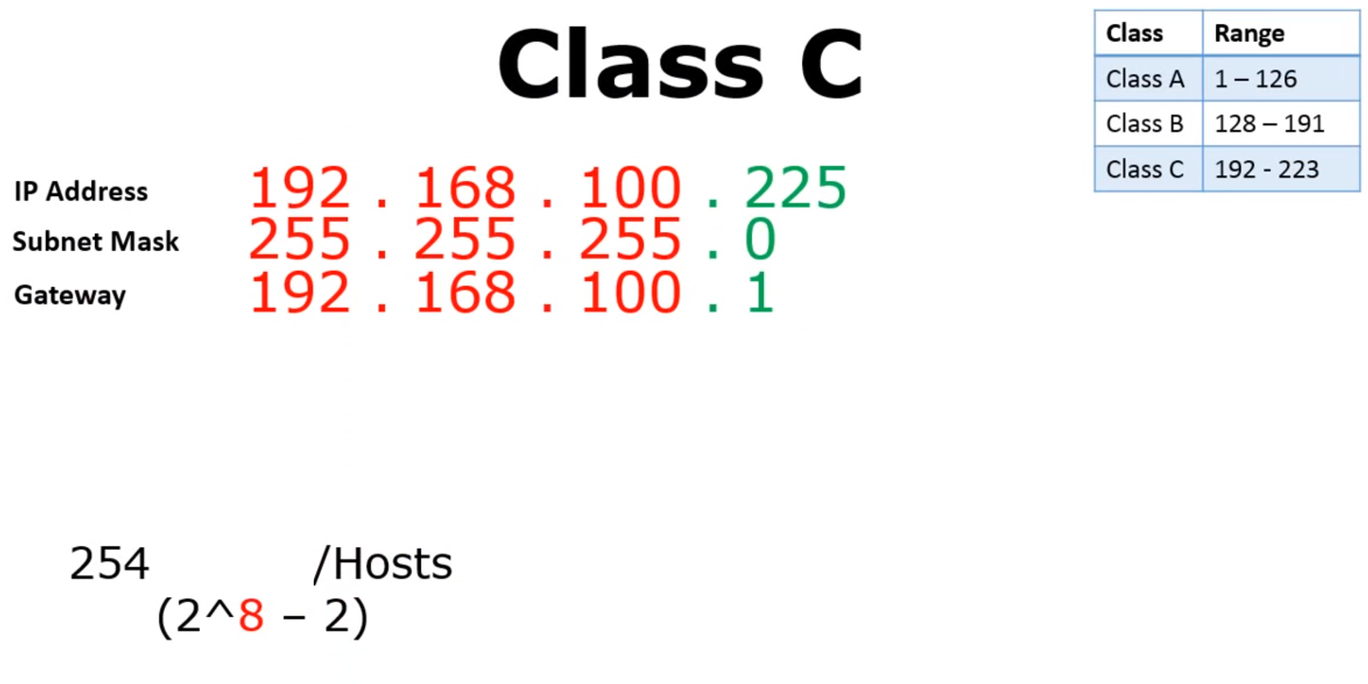
Class | Range
Class A | 1-127
Class B | 128-191
Class C | 192-223
The gateway address (or default gateway) is a router interface connected to the local network that sends packets out of the local network. The gateway has a physical and a logical address.
The subnet mask tells you which portion is the network which requires an understanding of the binary representation of the decimal values.

Slide 12
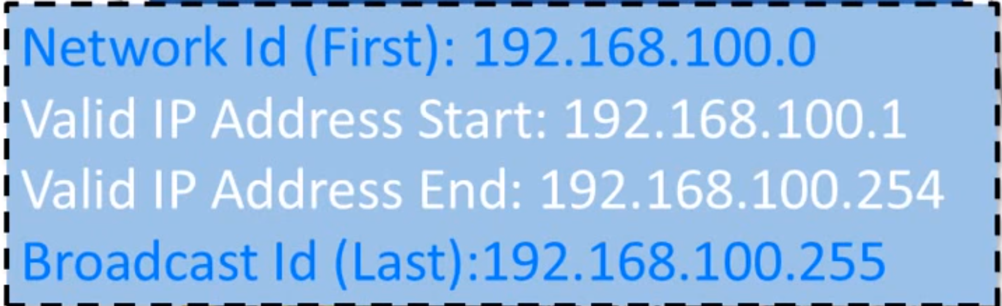
Class | Range
Class A | 1-127
Class B | 128-191
Class C | 192-223
11111111-11111111-11111111-00000000
/24

Slide 13
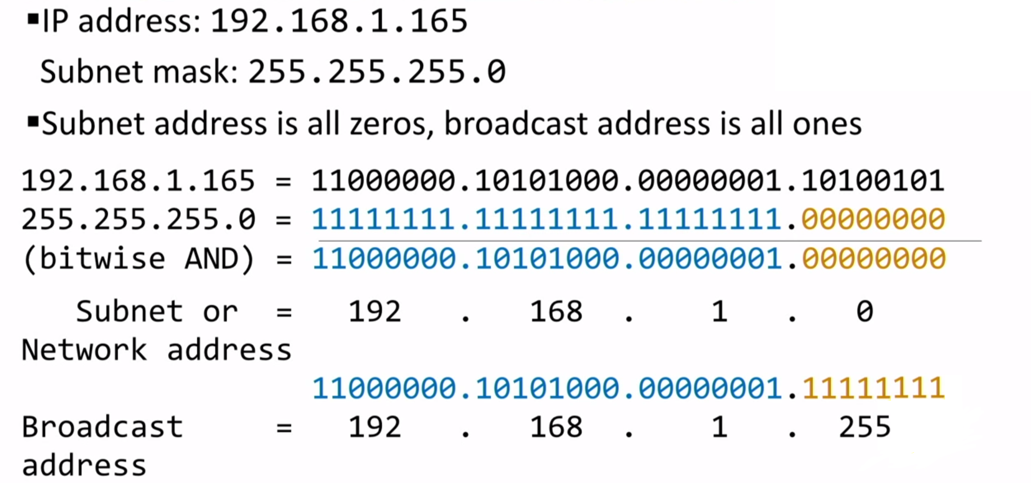
Network address and Broadcast address

Slide 14
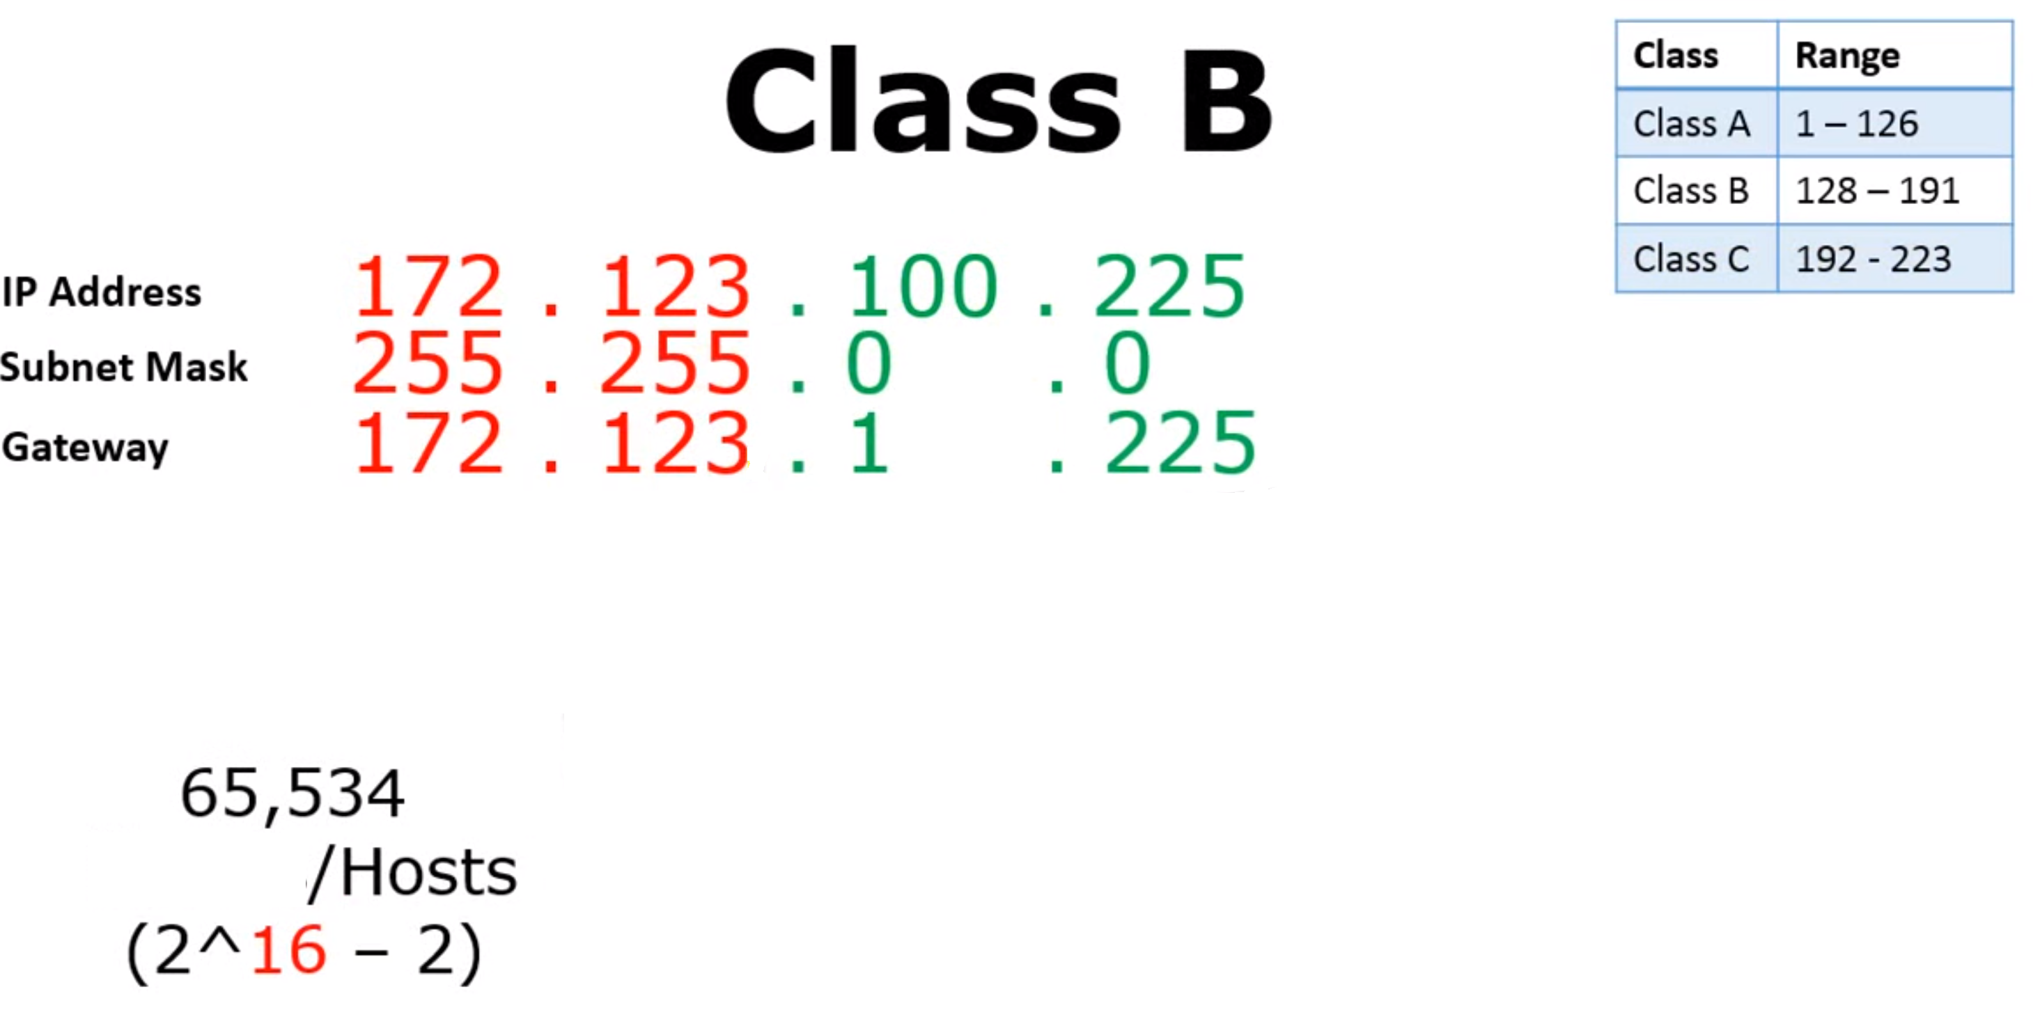
Class | Range
Class A | 1-127
Class B | 128-191
Class C | 192-223

Slide 15
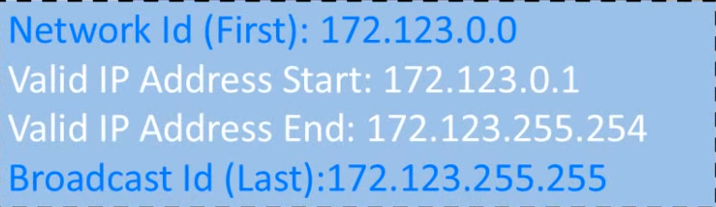
Class | Range
Class A | 1-127
Class B | 128-191
Class C | 192-223
/16

Slide 16
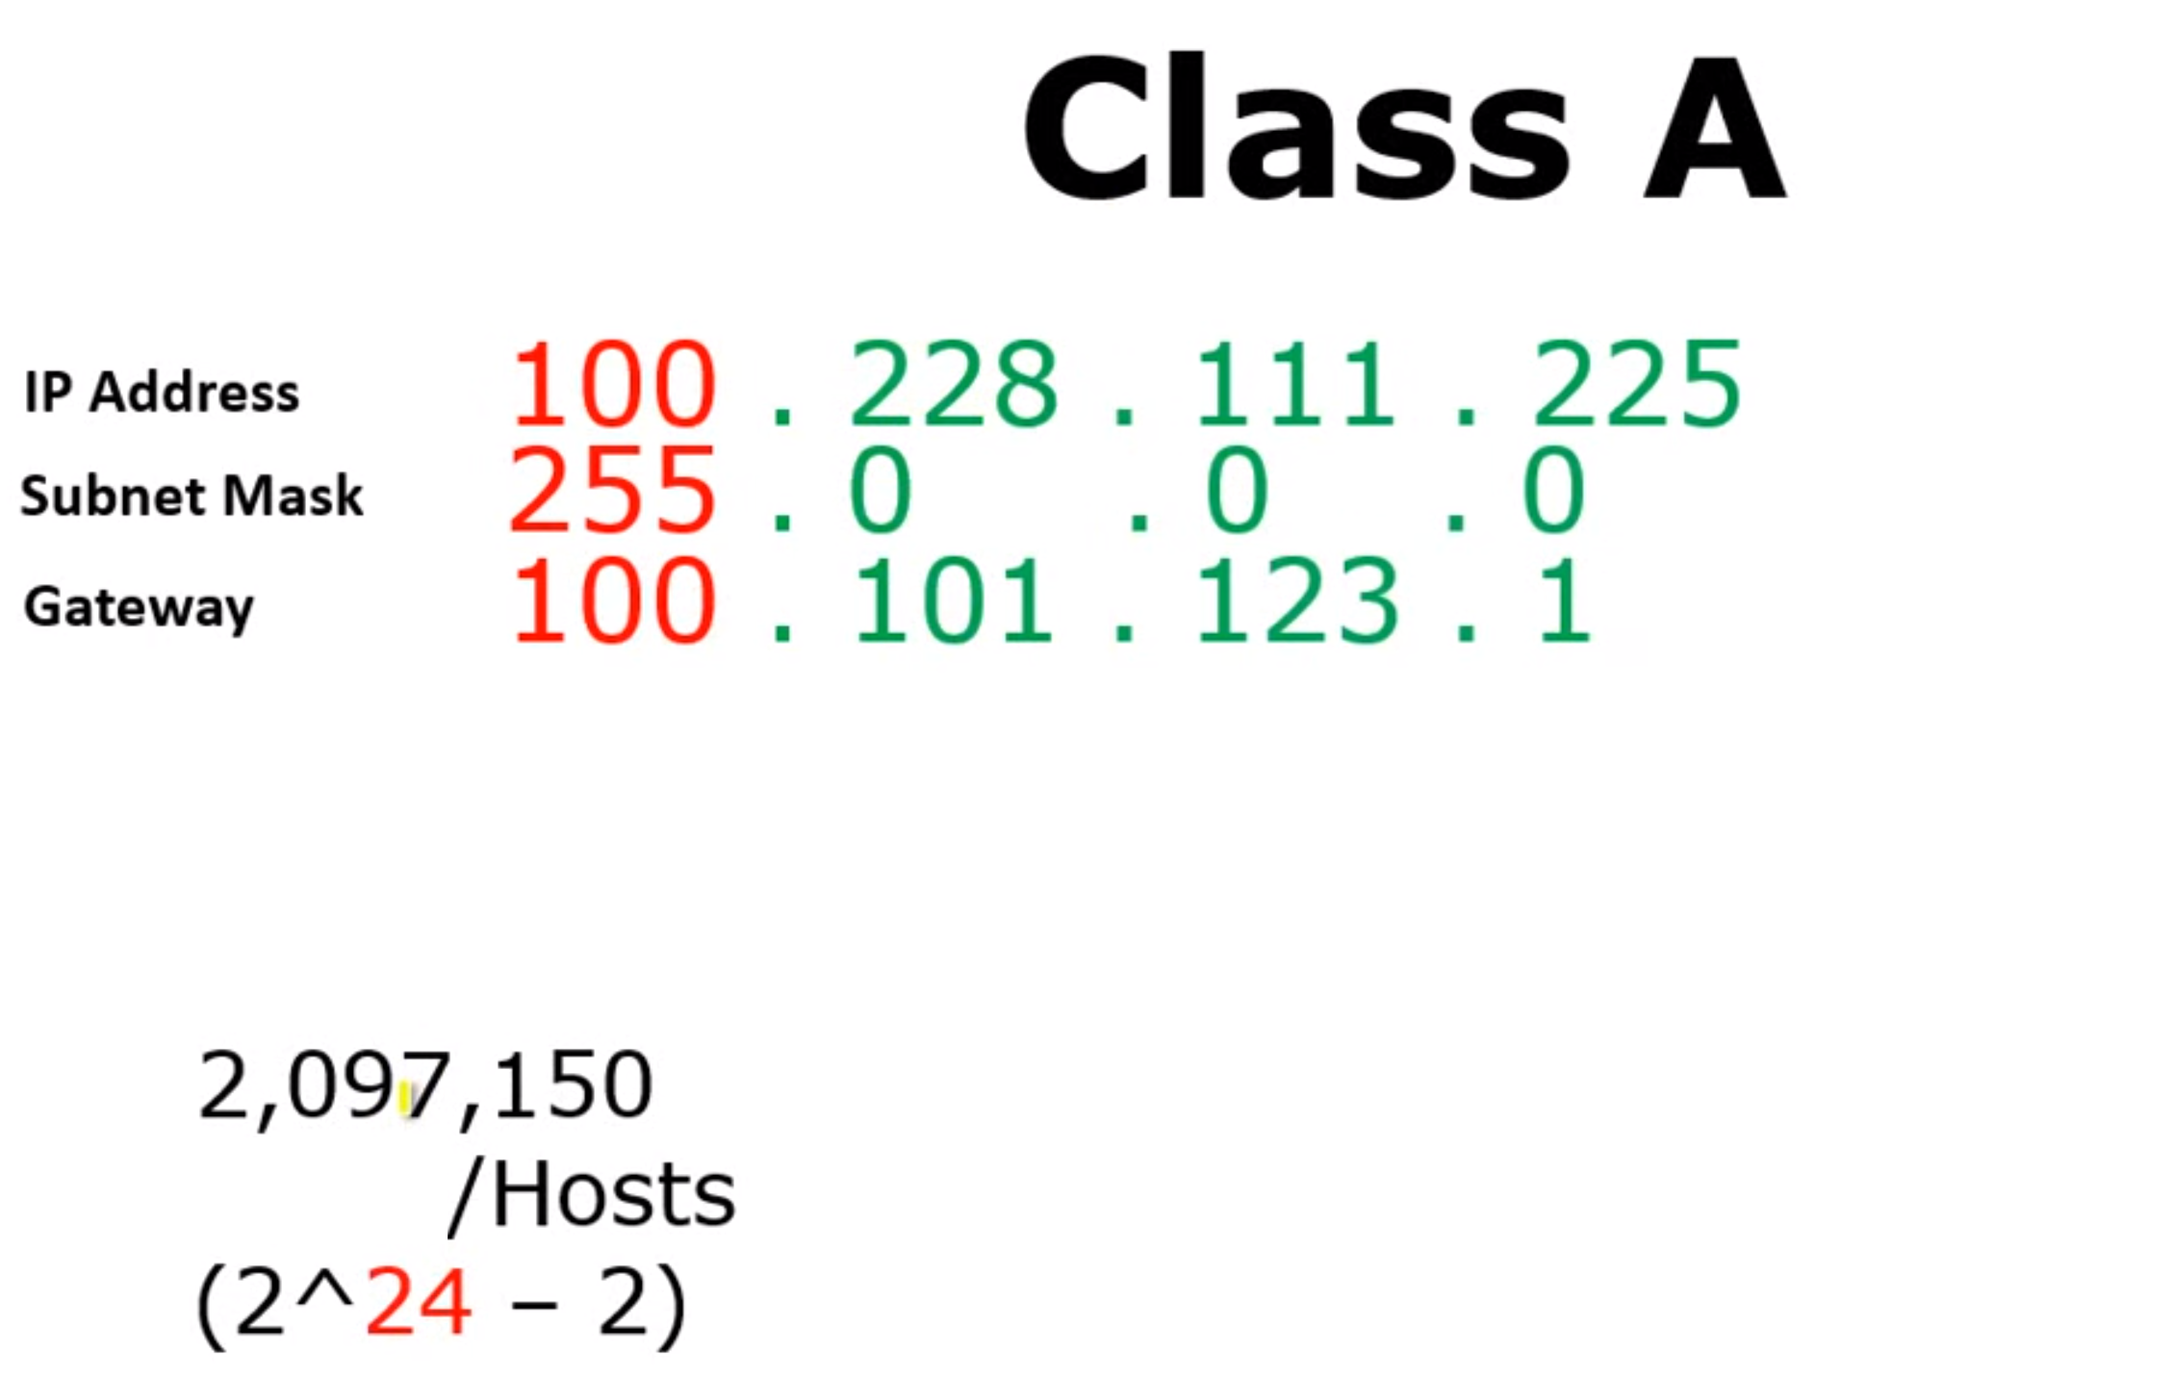
Class | Range
Class A | 1-127
Class B | 128-191
Class C | 192-223
/8

Slide 17
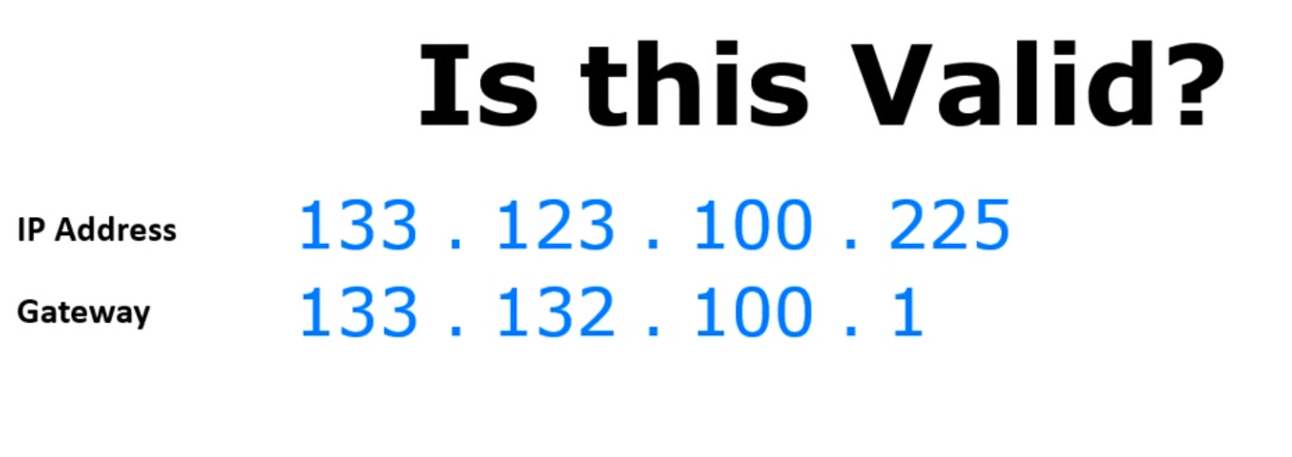
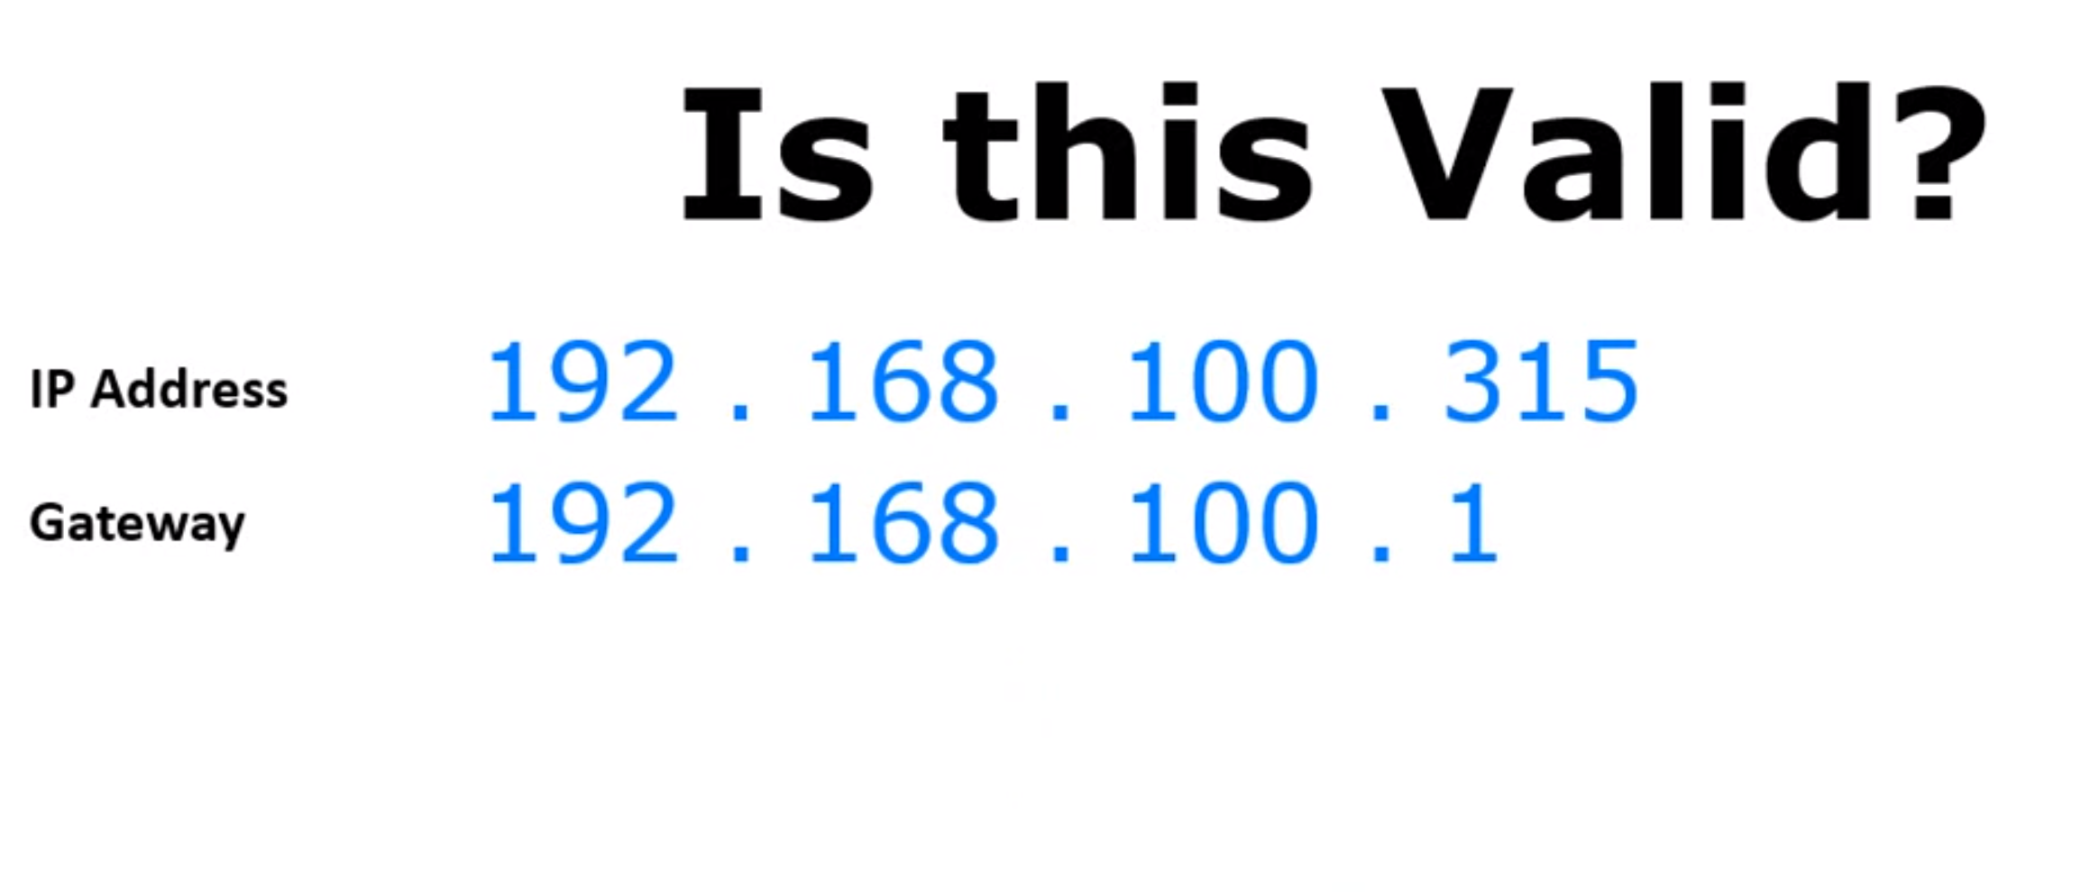
Class | Range
Class A | 1-127
Class B | 128-191
Class C | 192-223
X
Class | Range
Class A | 1-127
Class B | 128-191
Class C | 192-223
X

Slide 18
Problems with Classful IP Addresses
By the early 1990s, the original classful address scheme had a number of problems
Flat address space
Routing tables on the backbone Internet need to have an entry for each network address
When Class C networks were widely used, this created a problem
By the 1993, the size of the routing tables started to outgrow the capacity of routers
Other problems:
Too few network addresses for large networks
Class A and Class B addresses were gone
Limited flexibility for network addresses:
Class A and B addresses are overkill (>64,000 addresses)
Class C address is insufficient

Slide 19

Subnets
223.1.1.1
What’s a subnet ?
device interfaces that can physically reach each other without passing through an intervening router
223.1.2.1
223.1.1.2
223.1.1.4
223.1.2.9
223.1.1.3
223.1.3.27
223.1.2.2
IP addresses have structure:
subnet part: devices in same subnet have common high order bits
host part: remaining low order bits
223.1.3.1
223.1.3.2
network consisting of 3 subnets

Slide 20
Subnets
subnet 223.1.1.0/24
223.1.1.1
subnet 223.1.2.0/24
Recipe for defining subnets:
detach each interface from its host or router, creating “islands” of isolated networks
each isolated network is called a subnet
223.1.2.1
223.1.1.2
223.1.1.4
223.1.2.9
223.1.1.3
223.1.3.27
223.1.2.2
subnet
223.1.3.0/24
223.1.3.1
223.1.3.2
subnet mask: /24
(high-order 24 bits: subnet part of IP address)

Slide 21
Subnets
223.1.1.2
subnet 223.1.1/24
where are the subnets?
what are the /24 subnet addresses?
223.1.1.1
223.1.1.4
223.1.1.3
223.1.9.2
223.1.7.2
subnet 223.1.7/24
subnet 223.1.9/24
223.1.9.1
223.1.7.1
223.1.8.1
223.1.8.2
subnet 223.1.2/24
223.1.2.6
subnet 223.1.8/24
223.1.3.27
subnet 223.1.3/24
223.1.2.1
223.1.2.2
223.1.3.1
223.1.3.2

Slide 22
Subnetting
Problem: Organizations have multiple networks which are independently managed
Solution 1: Allocate a separate network address for each network
Difficult to manage
From the outside of the organization, each network must be addressable
Solution 2: Add another level of hierarchy to the IP addressing structure
University Network
Engineering
School
Medical
School
Library
Subnetting

Slide 23
Address assignment with subnetting
Each part of the organization is allocated a range of IP addresses (subnets or subnetworks)
Addresses in each subnet can be administered locally
IP addresses are managed under the authority of the Internet Corporation for Assigned Names and Numbers (ICANN)
University Network
128.143.0.0/16
128.143.71.0/24 128.143.136.0/24
Engineering
School
Medical
School
128.143.56.0/24
Library
128.143.121.0/24

Slide 24
Basic Idea of Subnetting
Split the host number portion of an IP address into a subnet number and a (smaller) host number.
Result is a 3-layer hierarchy
network prefix
host number
network prefix
subnet number
host number
extended network prefix
Then:
Subnets can be freely assigned within the organization Internally,
Subnets are treated as separate networks
Subnet structure is not visible outside the organization
Notes:
Class D has IP address range from 224.0.0.0 to 239.255.255.255. Class D is reserved for Multicasting. In multicasting data is not destined for a particular host, that is why there is no need to extract host address from the IP address, and Class D does not have any subnet mask.
A router will determine if any of the hosts on a locally attached network are configured to receive multicast datagrams using IGMP( Internet Group Management Protocol).
Class E IP address is reserved for experimental purposes only for R&D or Study. IP addresses in this class ranges from 240.0.0.0 to 255.255.255.254. Like Class D, this class too is not equipped with any subnet mask.

Slide 25
IP address types
Loopback (localhost): Used to test the IP stack on the local computer. Can be any address from 127.0.0.1 through 127.255.255.254
Layer 2 broadcasts (Hardware broadcast: 48 bits): These are sent to all nodes on a LAN
Broadcasts (layer 3): These are sent to all nodes on the network
Unicast: This is an address for a single interface, and these are used to send packets to a single destination host
Multicast: These are packets sent from a single source and transmitted to many devices on different networks. Referred to as “one-to-many”

Slide 26
Subnetting table (to remember)
Start with 1, double until you reach 128
Subtract top row from 256
From /32, list CIDR notation
Group size | 128 | 64 | 32 | 16 | 8 | 4 | 2 | 1
Subnet mask | 128 | 192 | 224 | 240 | 248 | 252 | 254 | 255
CIDR | /25 | /26 | /27 | /28 | /29 | /30 | /31 | /32

Slide 27
Subnetting—(The five questions)
How many subnets does the chosen subnet mask produce?
How many valid hosts per subnet are available?
What are the valid subnets?
What’s the broadcast address of each subnet?
What are the valid hosts in each subnet?
Reference: Lammle, Todd. CCNA Routing and Switching Complete Study Guide: Exam 100-105, John Wiley & Sons, 2016

Slide 28
Subnetting—The Fast Way!
How many subnets?
2 = number of subnets where x is the number of masked bits, or the 1s
How many hosts per subnet?
2 – 2 = number of hosts per subnet, where y is the number of unmasked bits, or the 0s
What are the valid subnets?
256 – subnet mask = block size, or increment number
Example: for a subnet mask: 192 use the following math e.g., 256 – 192 = 64
The block size of a 192 mask is always 64
Start counting at zero in blocks of 64 until you reach the subnet mask value and these are your subnets in the fourth octet: 0, 64, 128, 192
x
Y
Reference: Lammle, Todd. CCNA Routing and Switching Complete Study Guide: Exam 100-105. John Wiley & Sons, 2016

Slide 29
Subnetting—The Fast Way!
What’s the broadcast address for each subnet?
The broadcast address is always the number right before the next subnet
For example, the 0 subnet has a broadcast address of 63 because the next subnet is 64 and The 64 subnet has a broadcast address of 127 because the next subnet is 128, and so on
Remember, the broadcast address of the last subnet is always 255
What are the valid hosts?
Valid hosts are the numbers between the subnets, omitting the all-0s and all-1s. For example, if 64 is the subnet number and 127 is the broadcast address, then from 65 to 126 are the valid hosts
Your valid host range is always the group of numbers between the subnet address and the broadcast address
Reference: Lammle, Todd. CCNA Routing and Switching Complete Study Guide: Exam 100-105,. John Wiley & Sons, 2016

Slide 30
Example (Address Class C)
Lets practice Class C: subnetting of : 255.255.255.128 (/25)
Consider a network address: 192.168.10.0
And subnet mask: 255.255.255.128
Now, let’s answer our big five:
How many subnets?
Since 128 is 1 bit on (10000000), the answer would be 2^1 = 2
How many hosts per subnet?
We have 7 host bits off (10000000), so the equation would be 2^7 – 2 = 126 hosts
Once you figure out the block size of a mask, the amount of hosts is always the block size minus 2
What are the valid subnets?
block size = 256 – subnet mask, e.g., 256 – 128 = 128
we’ll start at zero and count in our block size, so our subnets are 0 and 128
Reference: Lammle, Todd. CCNA Routing and Switching Complete Study Guide: Exam 100-105, John Wiley & Sons, 2016

Slide 31
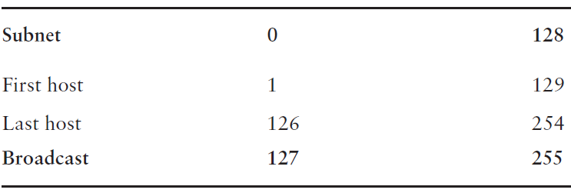
Example (Address Class C)
What’s the broadcast address for each subnet?
The number right before the value of the next subnet is all host bits turned on and equals the broadcast address
For the zero subnet, the next subnet is 128, so the broadcast of the 0 subnet is 127
What are the valid hosts?
These are the numbers between the subnet and broadcast Address
Reference: Lammle, Todd. CCNA Routing and Switching Complete Study Guide: Exam 100-105, John Wiley & Sons, 2016

Slide 32
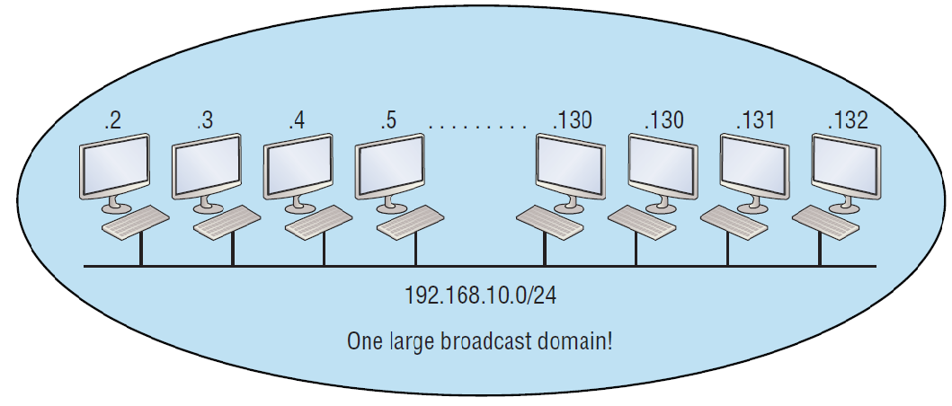
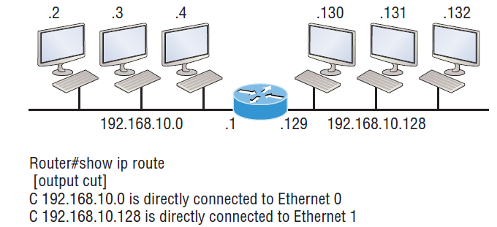
Implementing a Class C /25 logical network
One network
Multiple networks connected together
Reference: Lammle, Todd. CCNA Routing and Switching Complete Study Guide: Exam 100-105,John Wiley & Sons, 2016

Slide 33
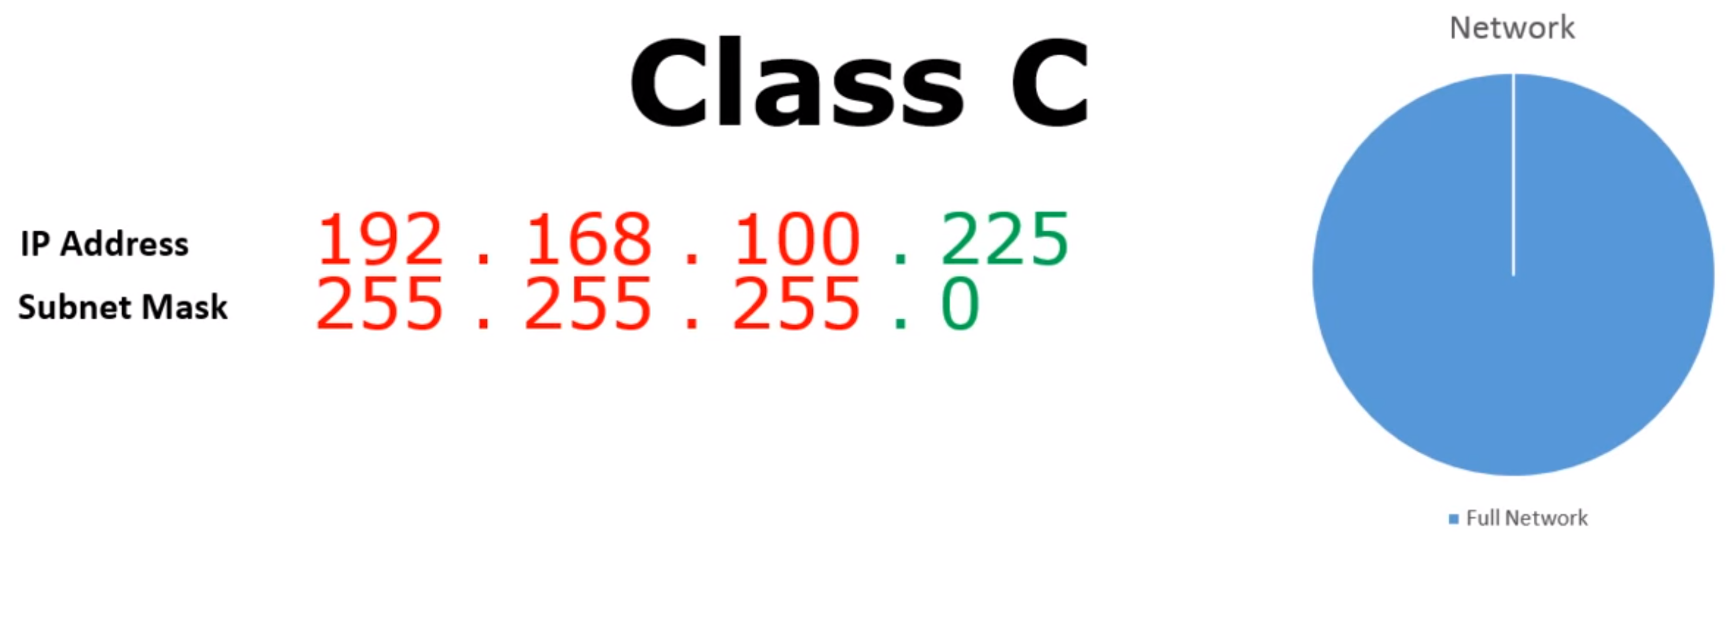
Subnetting: Example1

Slide 34
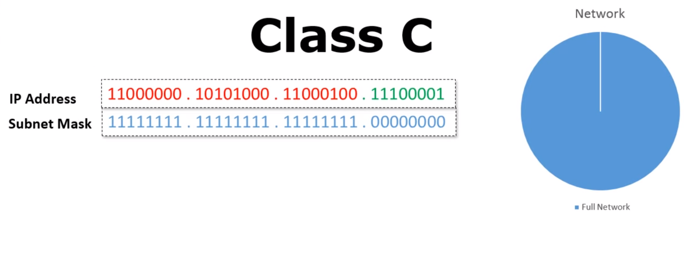
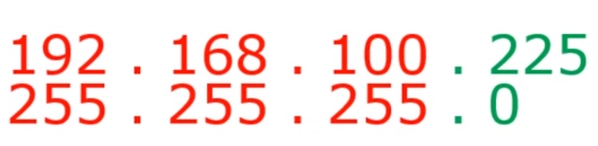
Subnetting: Example1
11111111
254 Hosts
2^8 - 2 = 254 Hosts
Network ID: 192.168.100.0
Broadcast ID: 192.168.100.255

Slide 35
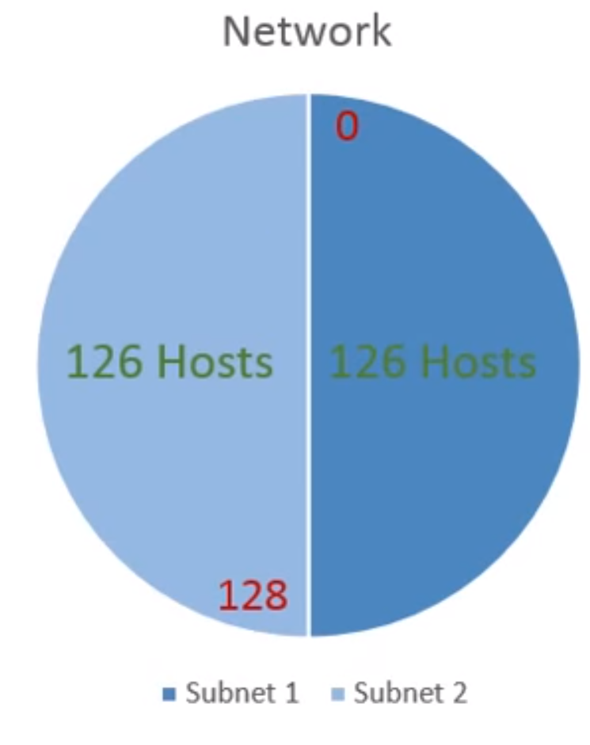
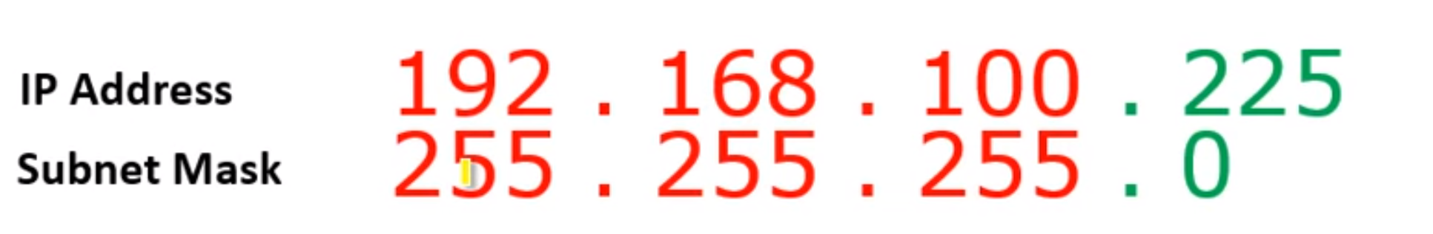
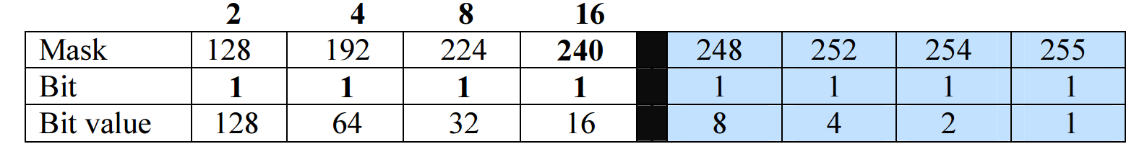
Subnetting: Example1
11111111 . 11111111 . 11111111 . 00000000
11111111 . 11111111 . 11111111 . 10000000
subnet number
host number

Slide 36
Subnetting: Example1
11111111 . 11111111 . 11111111 . 00000000
11111111 . 11111111 . 11111111 . 10000000
Network ID 1: 192.168.100.0
/25
Broadcast ID 1: 192.168.100.127
/25
Network ID 2: 192.168.100.128
/25
Broadcast ID 1: 192.168.100.255
/25
New Subnet Mask:
255.255.255.128

Slide 37
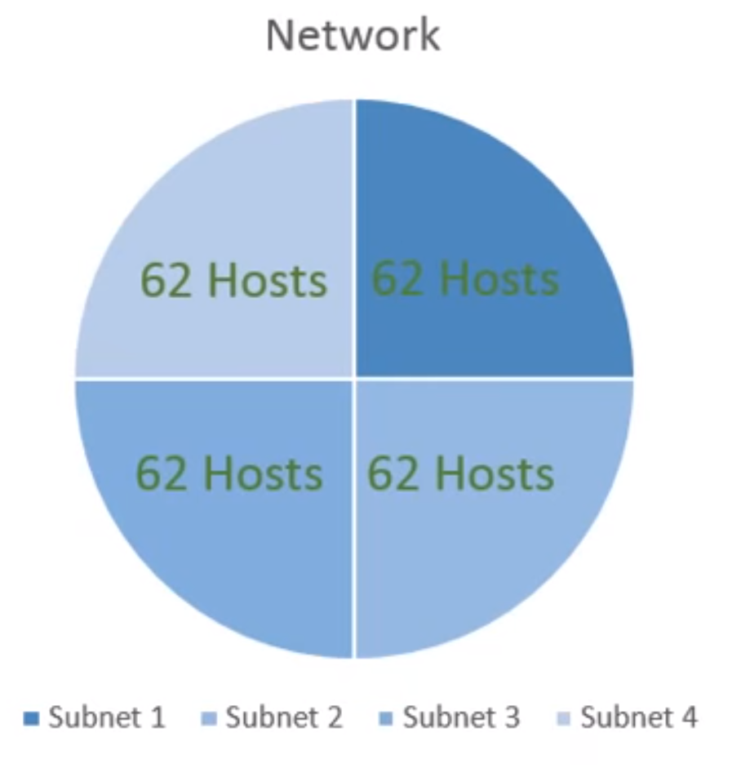
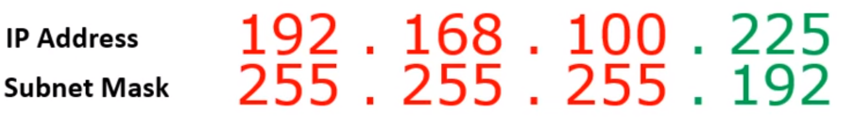
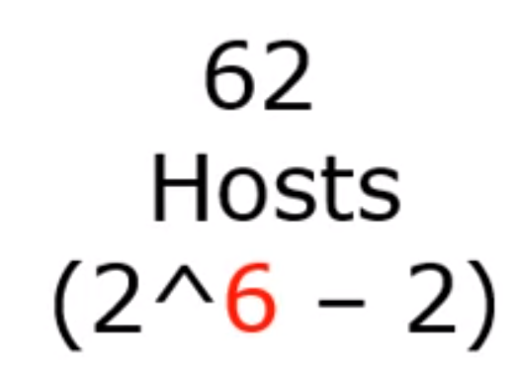
Subnetting Example-2
192 . 168 . 100 . 225/26
OR
11111111 . 11111111 . 11111111 . 11000000

Slide 38
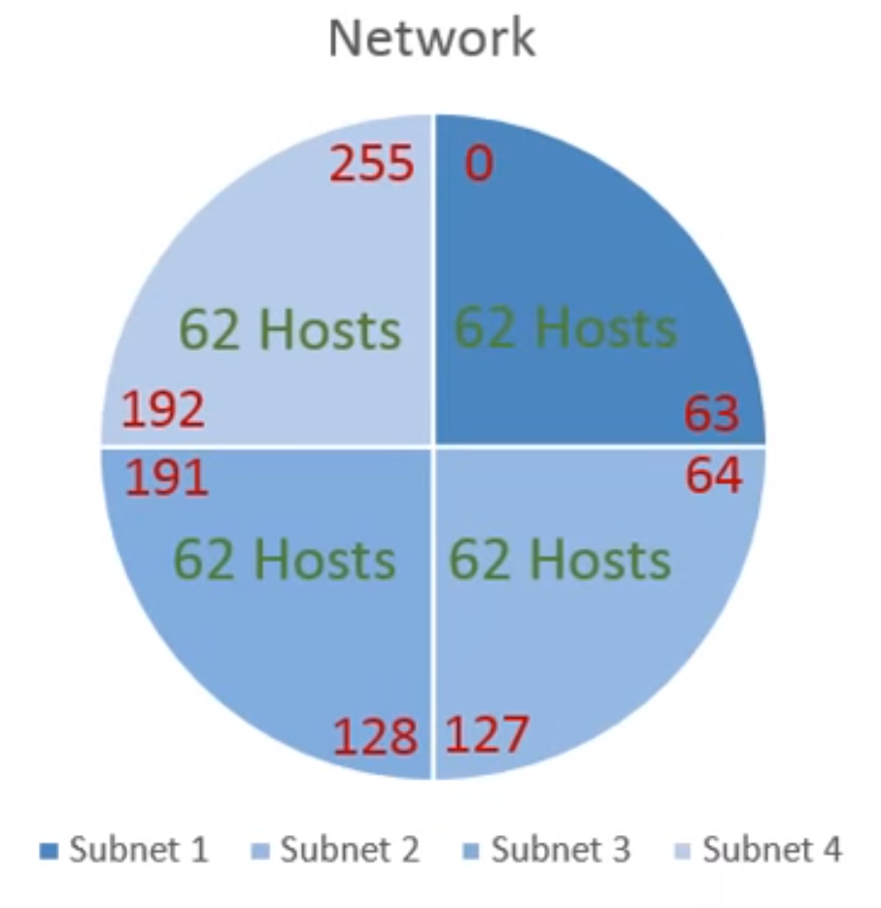
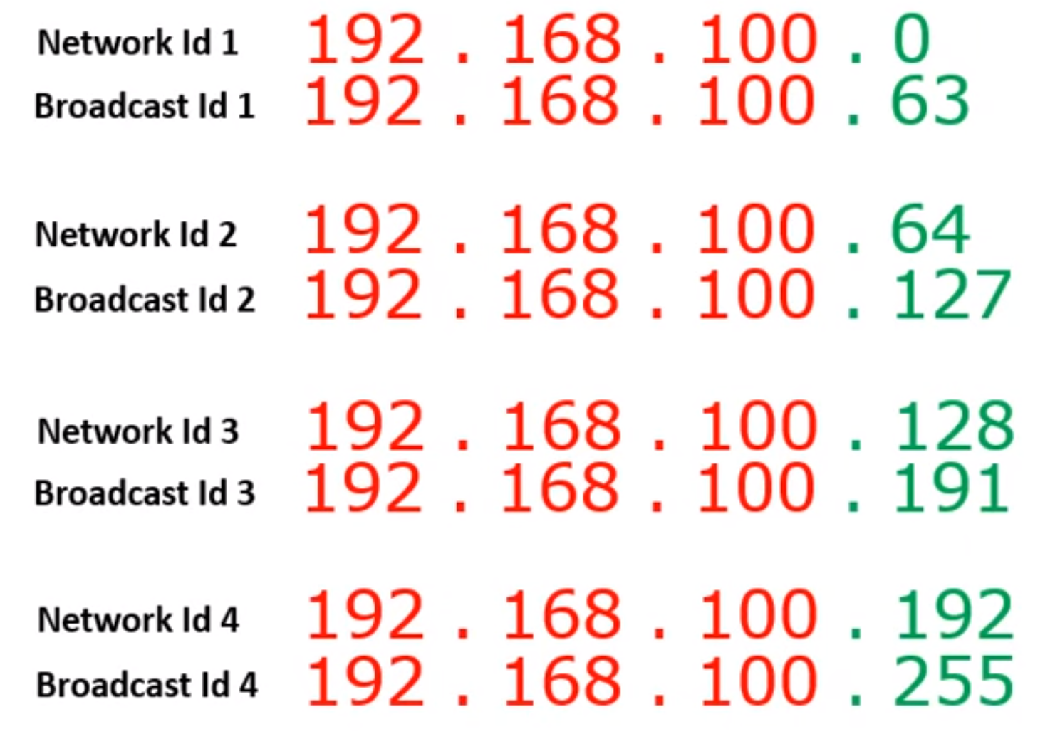
Subnetting
11111111 . 11111111 . 11111111 . 11000000

Slide 39
Our subnet planning mission
We have been assigned an address of 201.222.5.0. Assume 25 subnets are needed, with 5 hosts per subnet. Our mission is to identify each subnet address and the addresses of all hosts under each subnet.
Step 1. Convert the decimal dotted notation address 201.222.5.0/24 to binary:
11001001.11011110.00000101.00000000
Step 2. Determine the Network part of the IP Address 201.222.5.0/24:
201.222.5.0/24 means how many bits for the network?

Slide 40
Step 3. Determine what part of the IP address is the network portion and what part of the address is the host portion:
11001001.11011110.00000101.00000000
Network .Network .Network .Host
Step 4. Determine how many bits you need to borrow from the last octet (host portion) of the IP Address to give you the needed 25 subnets:
2 to the power of 1 = 2 subnets
2 to the power of 2 = 4 subnets
2 to the power of 3 = 8 subnets
2 to the power of 4 = 16 subnets
2 to the power of 5 = 32 subnets
2 to the power of 6 = 64 subnets

Slide 41
Step 5. Since you borrowed five bits from the host for subnets, determine how many hosts can you have on each of those subnets?
2 to the power of 3 = 8 hosts (less 2) giving you 6 hosts per subnet
2^3 - 2 = 6 Hosts/subnet
Notes:
Section G: 15-12-2021

Slide 42
Step 6. Determine the Binary Subnetworks Field Numbers (32 possible combinations):
Subnet # Binary Subnetwork
1 00000
2 00001
3 00010
4 00011
5 00100
6 00101
7 00110
8 00111
9 01000
10 01001
11 01010
12 01011
13 01100
.. ……..
32 11111

Slide 43
Step 7. Determine the Range of Binary Host Field Numbers for Each Subnetwork:
Subnet # Binary Subnetwork Range of Host #’s
1 00000 000 - 111
2 00001 000 - 111
3 00010 000 - 111
4 00011 000 - 111
5 00100 000 - 111
6 00101 000 - 111
7 00110 000 - 111
8 00111 000 - 111
9 01000 000 - 111
10 01001 000 - 111
11 01010 000 - 111
12 01011 000 - 111
13 01100 000 - 111
.. …….. -----------
32 11111 000 - 111
Original IP:
11001001.11011110.00000101.XXXXX000
to
11001001.11011110.00000101.XXXXX111

Slide 44
Step 8. Determine Decimal Host Numbers for Each Subnetwork:
Subnet # Binary Subnetwork Range of Host #’s Decimal Host Numbers
1 00000 000 – 111 .0 - .7
2 00001 000 - 111 .8 - .15
3 00010 000 - 111 .16 - .23
4 00011 000 - 111 .24 - .31
5 00100 000 - 111 .32 - .39
6 00101 000 - 111 .40 - .47
7 00110 000 - 111 .48 - .55
8 00111 000 - 111 .56 - .63
9 01000 000 - 111 .64 - .71
10 01001 000 - 111 .72 - .79
11 01010 000 - 111 .80 - .87
12 01011 000 - 111 .88 - .95
13 01100 000 - 111 .96 - 103
.. …….. ----------- ----------
32 11111 000 - 111 .248 - 255

Slide 45
Step 9. Determine Our Subnet Addresses:
# Binary Subnetwork Range of Host #’s Decimal Host #’s Subnet Address
1 00000 000 - 111 .0 - .7 201.222.5.0
2 00001 000 - 111 .8 - .15 201.222.5.8
3 00010 000 - 111 .16 - .23 201.222.5.16
4 00011 000 - 111 .24 - .31 201.222.5.24
5 00100 000 - 111 .32 - .39 201.222.5.32
6 00101 000 - 111 .40 - .47 201.222.5.40
7 00110 000 - 111 .48 - .55 201.222.5.48
8 00111 000 - 111 .56 - .63 201.222.5.56
9 01000 000 - 111 .64 - .71 201.222.5.64
10 01001 000 - 111 .72 - .79 201.222.5.72
11 01010 000 - 111 .80 - .87 201.222.5.80
12 01011 000 - 111 .88 - .95 201.222.5.88
13 01100 000 - 111 .96 - 103 201.222.5.96
.. .……. ----------- ---------- ---------------
32 11111 000 – 111 .248 – 255 201.222.5.248

Slide 46
Step 10. Determine Host Addresses of the Six Nodes of Each Subnet:
# Subnetwork Range of Host #’s Decimal Host #’s Subnet Address Host Address Range
1 00000 000 – 111 .0 - .7 201.222.5.0 201.222.5.1 thru 201.222.5.6
2 00001 000 - 111 .8 - .15 201.222.5.8 201.222.5.9 thru 201.222.5.14
3 00010 000 - 111 .16 - .23 201.222.5.16 201.222.5.17 thru 201.222.5.22
4 00011 000 - 111 .24 - .31 201.222.5.24 201.222.5.25 thru 201.222.5.30
5 00100 000 - 111 .32 - .39 201.222.5.32 201,222,5,33 thru 201.222.5.38
6 00101 000 - 111 .40 - .47 201.222.5.40 201.222.5.41 thru 201.222.5.46
7 00110 000 - 111 .48 - .55 201.222.5.48 201.222.5.49 thru 201.222.5.54
8 00111 000 - 111 .56 - .63 201.222.5.56 201.222.5.57 thru 201.222.5.62
9 01000 000 - 111 .64 - .71 201.222.5.64 201.222.5.65 thru 201.222.5.70
10 01001 000 - 111 .72 - .79 201.222.5.72 201.222.5.73 thru 201.222.5.78
11 01010 000 - 111 .80 - .87 201.222.5.80 201.222.5.81 thru 201.222.5.86
12 01011 000 - 111 .88 - .95 201.222.5.88 201.222.5.89 thru 201.222.5.94
13 01100 000 - 111 .96 - 103 201.222.5.96 201.222.5.97 thru 201.222.5.--
.. .……. ----------- ---------- --------------- -------------------------------------
32 11111 000 - 111 . 248- 255 201.222.5.248 201.222.5.249 thru 201.222.5.254

Slide 47
Step 11. Determine Broadcast Addresses of Each Subnet:
Range of Decimal Subnet Host Broadcast
# Subnetwork Host #’s Host #’s Address Address Range Address
1 00000 000 – 111 .0 - .7 201.222.5.0 201.222.5.1 thru 201.222.5.6 201.222.5.7
2 00001 000 - 111 .8 - .15 201.222.5.8 201.222.5.9 thru 201.222.5.14 201.222.5.15
3 00010 000 - 111 .16 - .23 201.222.5.16 201.222.5.17 thru 201.222.5.22 201.222.5.23
4 00011 000 - 111 .24 - .31 201.222.5.24 201.222.5.25 thru 201.222.5.30 201.222.5.31
5 00100 000 - 111 .32 - .39 201.222.5.32 201,222,5,33 thru 201.222.5.38 201.222.5,39
6 00101 000 - 111 .40 - .47 201.222.5.40 201.222.5.41 thru 201.222.5.46 201.222.5.47
7 00110 000 - 111 .48 - .55 201.222.5.48 201.222.5.49 thru 201.222.5.54 201.222.5.55
8 00111 000 - 111 .56 - .63 201.222.5.56 201.222.5.57 thru 201.222.5.62 201.222.5.63
9 01000 000 - 111 .64 - .71 201.222.5.64 201.222.5.65 thru 201.222.5.70 201.222.5.71
10 01001 000 - 111 .72 - .79 201.222.5.72 201.222.5.73 thru 201.222.5.78 201.222.5.79
11 01010 000 - 111 .80 - .87 201.222.5.80 201.222.5.81 thru 201.222.5.86 201.222.5.87
12 01011 000 - 111 .88 - .95 201.222.5.88 201.222.5.89 thru 201.222.5.94 201.222.5.95
13 01100 000 - 111 .96 - 103 201.222.5.96 201.222.5.97 thru 201.222.5.-- ----------------
.. .……. ----------- ---------- --------------- ------------------------------------- ----------------
32 11111

Slide 48
Step 12. Determine the subnet mask for network 201.222.5.0 (remember that 5 bits were borrowed):
11111111.11111111.11111111.11111 000
Network Network Network Subnet Host
A data frame with a destination IP Address of 201.222.5.21 would be used by the router, along with the submask of 255.255.255.248, to determine the correct subnet to switch the data to in the switching process:

Slide 49
“ANDING” Process Performed by Router
IP Address: 11001001.11011110.00000101.00010101
Subnet Mask: 11111111.11111111.11111111.11111000
Subnet: 11001001.11011110.00000101.00010000
(Subnet in Decimal Dotted Notation: 201.222.5.16)

Slide 50
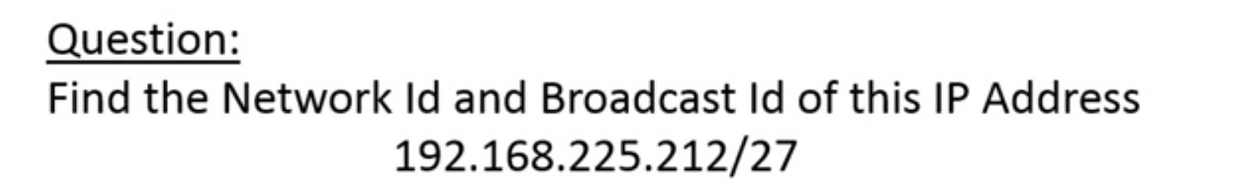
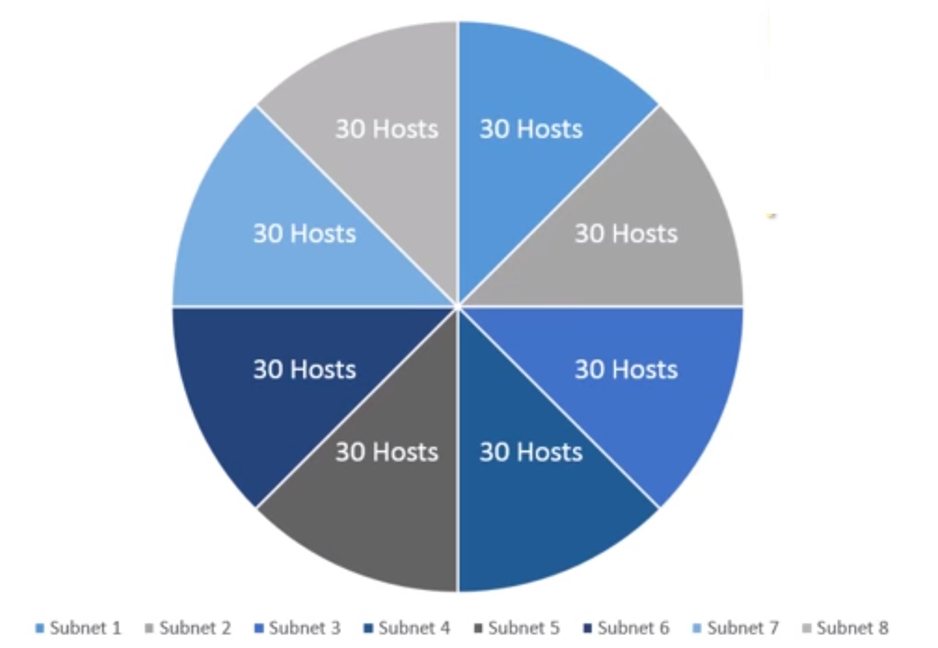
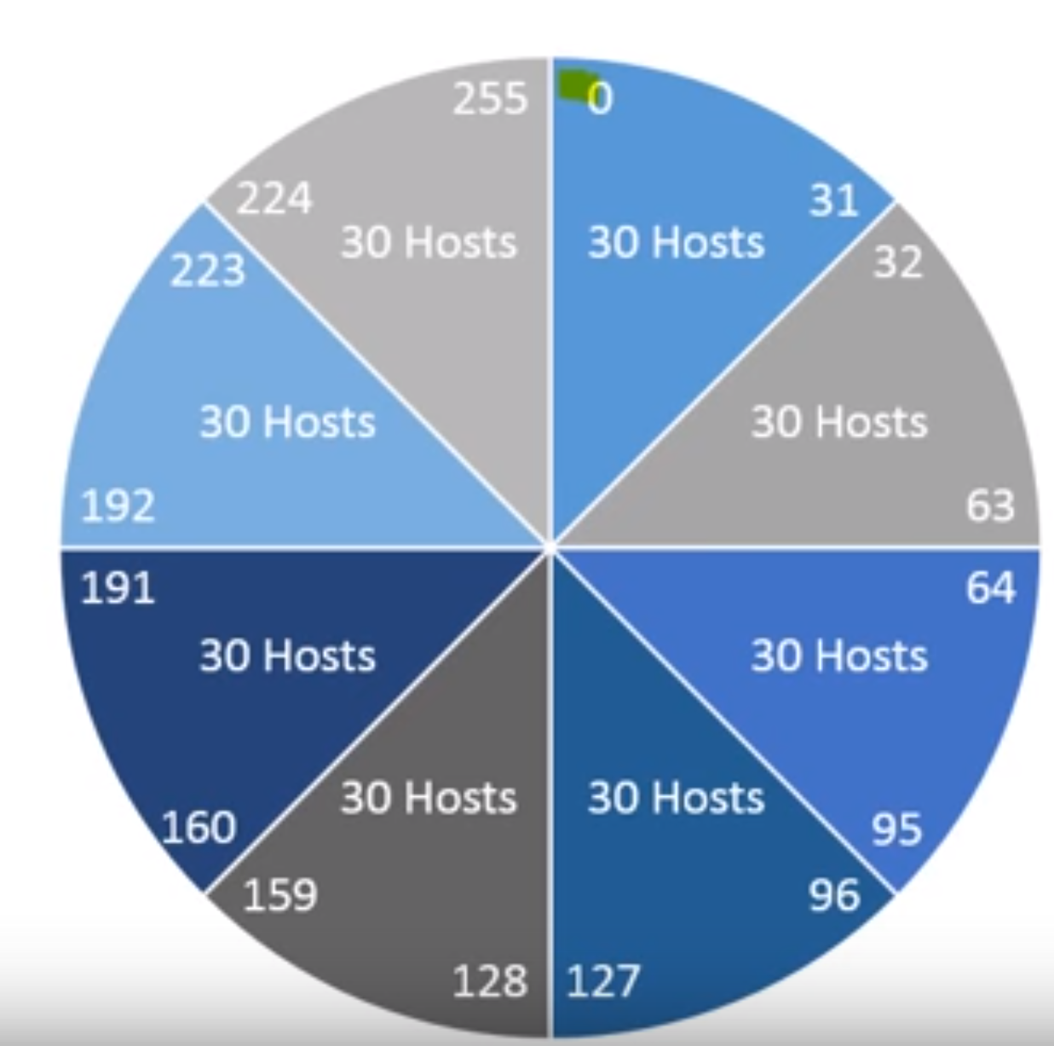
Also, figure out the number of subnets and
number of usable hosts in each subnet
Subnetting Calculator and Learning tutorial: (1) https://subnetipv4.com/ (2) https://subnetipv4.com/#learn
Notes:
Section D: 15-12-2021

Slide 51
Example1
Group size | 128 | 64 | 32 | 16 | 8 | 4 | 2 | 1
S. mask | 128 | 192 | 224 | 240 | 248 | 252 | 254 | 255
CIDR | /25 | /26 | /27 | /28 | /29 | /30 | /31 | /32
Subnetting of: 10.1.1.55 /28or Subnet mask: 255.255.255.240
Information needed | Detail | IP addresses
Network ID | First IP address in each Network | 10.1.1.48
Broadcast IP | Last IP address in each Network | 10.1.1.63
First Host IP | IP address after the Network ID | 10.1.1.49
Last Host IP | IP address before the Broadcast IP | 10.1.1.62
Next Network | IP address after the Broadcast IP | 10.1.1.64
IP Address | Number of IP addresses in each Network | 16
CIDR/subnet | Converting between CIDR/subnet Mask | 255.255.255.240
Subnetting Calculator and Learning tutorial: (1) https://subnetipv4.com/ (2) https://subnetipv4.com/#learn

Slide 52
Practice Example Class-B: 255.255.128.0 (/17)
Network address: 172.16.0.0
Subnet mask: 255.255.128.0
How many subnets?
Subnets = 2 = 2 = 2
How many hosts per subnet?
Hosts per subnet = 2 -2= 2 – 2 = 32,766 (7 bits in the third octet, and 8 in the fourth)
Valid subnets? 256 – 128 = 128.
0 and 128: (Remember that subnetting is performed in the third octet, so the subnet numbers are really 0.0 and 128.0)
x
1
y
15

Slide 53
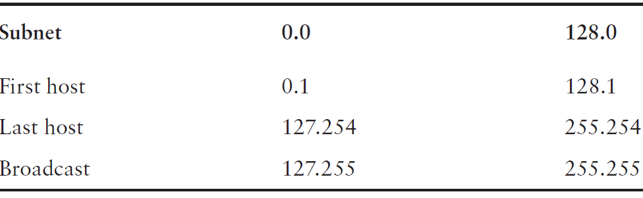
Broadcast addresses and valid hosts
Broadcast address for each subnet?
Valid hosts?

Slide 54
Practice Example Class-A: 255.255.0.0 (/16)
Network address: 10.0.0.0
Subnet mask: 255.255.0.0
How many subnets?
Subnets = 2 = 2 = 256
How many hosts per subnet?
Hosts per subnet = 2 = 2 – 2 = 65534
Valid subnets? Group size: 2= 2 =65536
The subnets would be 10.0.0.0, 10.1.0.0, 10.2.0.0, 10.3.0.0, etc., up to 10.255.0.0
x
8
y
16
y
16
Notes:
Section E: covered: 17.12.2021

Slide 55
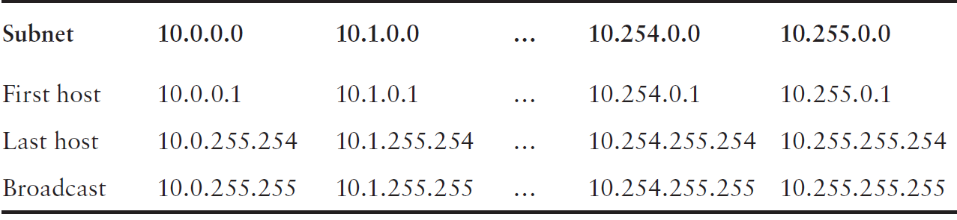
Broadcast addresses and valid hosts
Broadcast address for each subnet?
Valid hosts?

Slide 56
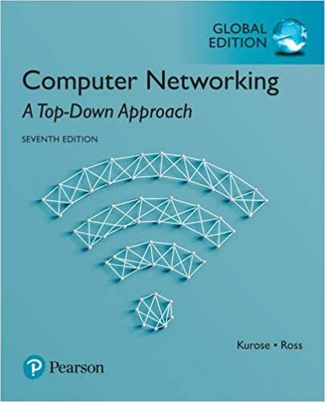

Thank You All
☺
?
A note on the origin of these ppt slides:
All material copyright 1996-2020 J.F Kurose and K.W. Ross, All Rights Reserved
These slides are freely provided by the book authors and it represents a lot of work on their part. We would like to thank J.F Kurose and K.W. Ross.
Transport Layer: 3-150
Notes:
Section F and G ended

